Slide 1
17
Dividends and Dividend Policy
Prepared by Anne Inglis, Ryerson University
Notes:
14.<number>

Slide 2
Financial management for engineers. Week 11: Summer 2019
Dividend policy
17-<number>

Slide 3
Cash Dividends 17.1
LO1
Regular cash dividend – cash payments made directly to stockholders, usually each quarter
Extra cash dividend – indication that the “extra” amount may not be repeated in the future
Liquidating dividend – some or all of the business has been sold
17-<number>
Notes:
14.<number>
Cash dividends reduce cash and retained earnings (except for liquidating dividends which may reduce paid-in capital)

Slide 4
Dividend Payment
LO1
Declaration Date – Board declares the dividend and it becomes a liability of the firm
Ex-dividend Date
  Occurs two business days before date of record
  If you buy stock on or after this date, you will not receive the dividend
  Stock price generally drops by about the amount of the dividend
Date of Record – Holders of record are determined and they will receive the dividend payment
Date of Payment – cheques are mailed
17-<number>
Notes:
14.<number>

Slide 5
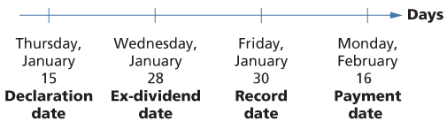
Figure 17.2 – Dividend Payment Chronology
LO1
17-<number>
Notes:
14.<number>

Slide 6
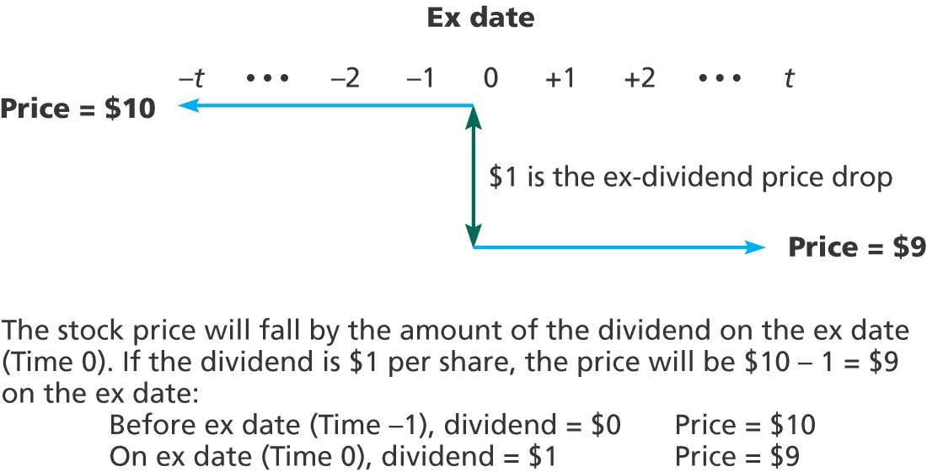
Figure 17.3 – Price Behaviour Around Ex-dividend Date
LO1
17-<number>
Notes:
14.<number>

Slide 7
Does Dividend Policy Matter? 17.2
LO2
Dividends matter – the value of the stock is based on the present value of expected future dividends
Dividend policy may not matter
  Dividend policy is the decision to pay dividends versus retaining funds to reinvest in the firm
  In theory, if the firm reinvests capital now, it will grow and can pay higher dividends in the future
17-<number>
Notes:
14.<number>

Slide 8
Illustration of Irrelevance
LO2
Consider a firm that can either pay out dividends of $10,000 per year for each of the next two years or can pay $9,000 in one year, reinvest the other $1,000 into the firm and then pay $11,120 in two years. Investors require a 12% return.
  Market Value with constant dividend = $16,900.51
  Market Value with reinvestment = $16,900.51
If the company will earn the required return, then it doesn’t matter when it pays the dividends
17-<number>
Notes:
14.<number>
Assuming that the second dividend is a liquidating dividend and the firm ceases to exist after period 2.
PV = 10,000 / 1.12 + 10,000 / 1.12² = 16,900.51
PV = 9000 / 1.12 + 11,120 / 1.12² = 16,900.51

Slide 9
Homemade Dividends
LO2
Dividend policy is irrelevant when there are no taxes or other market imperfections
Shareholders can effectively undo the firm’s dividend strategy
The shareholder who receives a dividend that is greater than desired can reinvest the excess
The shareholder who receives a dividend that is smaller than desired can sell extra shares of stock
17-<number>
Notes:
14.<number>

Slide 10
Low Payout Please 17.3
LO2
Why might a low payout be desirable?
Individuals in upper income tax brackets might prefer lower dividend payouts, with the immediate tax consequences, in favor of higher capital gains
Flotation costs – low payouts can decrease the amount of capital that needs to be raised, thereby lowering total flotation costs
Dividend restrictions – debt contracts might limit the percentage of income that can be paid out as dividends
17-<number>
Notes:
14.<number>
In November 2005, the Government of Canada initiated changes with the goal of making dividend-paying stocks more attractive in comparison to income trusts. The increase in the gross-up and the dividend tax credit makes the total personal and corporate income tax paid on income distributed as a dividend similar to the amount of tax that would be paid if the income were instead earned through an income trust.

Slide 11
Alternatives to Paying a Dividend
LO2
Select additional capital budgeting projects
Repurchase shares
Acquire other companies
Purchase financial assets
17-<number>
Notes:
14.<number>

Slide 12
High Payout Please 17.4
LO2
Why might a high payout be desirable?
Desire for current income
  Individuals in low tax brackets
Uncertainty resolution – no guarantee that the higher future dividends will materialize
Taxes
  Dividend exclusion for corporations
  Tax-exempt investors don’t have to worry about differential treatment between dividends and capital gains
17-<number>
Notes:
14.<number>

Slide 13
Dividends and Signals 17.5
LO2
Asymmetric information – managers have more information about the health of the company than investors
Changes in dividends convey information
17-<number>
Notes:
14.<number>

Slide 14
Dividend Increases
LO2
  Management believes higher dividend can be sustained
  Expectation of higher future dividends, increasing present value
  Signal of a healthy, growing firm
17-<number>
Notes:
14.<number>

Slide 15
Dividend Decreases
LO2
  Management believes it can no longer sustain the current level of dividends
  Expectation of lower dividends indefinitely; decreasing present value
  Signal of a firm that is having financial difficulties
17-<number>
Notes:
14.<number>

Slide 16
Clientele Effect
LO2
Some investors prefer low dividend payouts and will buy stock in those companies that offer low dividend payouts
Some investors prefer high dividend payouts and will buy stock in those companies that offer high dividend payouts
Investors will self-select into the stocks have their preferred payout policy
Managers should focus on capital budgeting decisions and ignore investor preferences
17-<number>
Notes:
14.<number>

Slide 17
Implications of the Clientele Effect
LO2
What do you think will happen if a firm changes its policy from a high payout to a low payout?
What do you think will happen if a firm changes its policy from a low payout to a high payout?
If this is the case, does dividend POLICY matter?
17-<number>
Notes:
14.<number>
If a firm changes its policy, it will just have different investors. Consequently, dividend policy won’t affect the value of the stock.

Slide 18
Residual Dividend Policy 17.6
LO2
Determine capital budget
Determine target capital structure
Finance investments with a combination of debt and equity in line with the target capital structure
  Remember that retained earnings are equity
  If additional equity is needed, issue new shares
If there are excess earnings, then pay the remainder out in dividends
17-<number>
Notes:
14.<number>
A strict residual dividend policy might lead to a very unstable dividend policy.

Slide 19
Example – Residual Dividend Policy
LO2
Given
  Need $5 million for new investments
  Target capital structure: D/E = 2/3
  Net Income = $4 million
Finding dividend
  40% financed with debt (2 million)
  60% financed with equity (3 million)
  NI – equity financing = $4 million - $3 million = $1 million, paid out as dividends
17-<number>
Notes:
14.<number>
Remind students how to get % debt and % equity given D/E:
If D/E = 2/3, the V = 2 + 3 = 5, so D/V = 2/5 = 40% and E/V = 3/5 = 60%

Slide 20
Compromise Dividend Policy
LO2
Goals, ranked in order of importance
  Avoid cutting back on positive NPV projects to pay a dividend
  Avoid dividend cuts
  Avoid the need to sell equity
  Maintain a target debt/equity ratio
  Maintain a target dividend payout ratio
Companies want to accept positive NPV projects, while avoiding negative signals
17-<number>
Notes:
14.<number>

Slide 21
Stock Repurchase17.7
LO4
Company buys back its own shares of stock
  Tender offer – company states a purchase price and a desired number of shares
  Open market – buys stock in the open market
Similar to a cash dividend in that it returns cash from the firm to the stockholders
This is another argument for dividend policy irrelevance in the absence of taxes or other imperfections
17-<number>
Notes:
14.<number>

Slide 22
Information Content of Stock Repurchases
LO4
Stock repurchases sends a positive signal that management believes that the current price is low
Tender offers send a more positive signal than open market repurchases because the company is stating a specific price
The stock price often increases when repurchases are announced
17-<number>
Notes:
14.<number>

Slide 23
Stock Dividends 17.8
LO3
Pay additional shares of stock instead of cash
Increases the number of outstanding shares
If you own 100 shares and the company declared a 10% stock dividend, you would receive an additional 10 shares
17-<number>
Notes:
14.<number>

Slide 24
Stock Splits
LO3
Stock splits – essentially the same as a stock dividend except expressed as a ratio
  For example, a 2 for 1 stock split is the same as a 100% stock dividend
Stock price is reduced when the stock splits
Common explanation for split is to return price to a “more desirable trading range”
17-<number>
Notes:
14.<number>

Slide 25
References
LD Booth and DJ Johnston. The ex Dividend Day Behaviour of Canadian stock prices: Tax changes and clientele effects. Journal of finance 39(June 1984) pp 457-76
R. La Porta , Lopez-de-Silanes. A. Schleifer and R.W. Vishny . Agency problems and dividend policies around the world. Journal of Finance Feb 2000 Vo.l 55 No 1
17-<number>

